Slide 1

Welcome to Spring 3.0

Slide 2
Chapter 1 – Spring Core
Inversion of Control /Dependency Injection (IoC/DI)
Part A | IOC Container (BeanFactory or ApplicationContext)
 | Managed Beans
 | Bean Lifecycle
Part B | XML Based DI
 | Annotation Based DI
 | Java Based DI
Validators and Convertors
Resources
Spring Expression Language (SpEL)

Slide 3
Presentation Layer
Business Layer
Lightweight IOC Container and AOP
Persistence Layer
DAO template support for popular ORMs and JDBC
MVC Framework

Slide 4
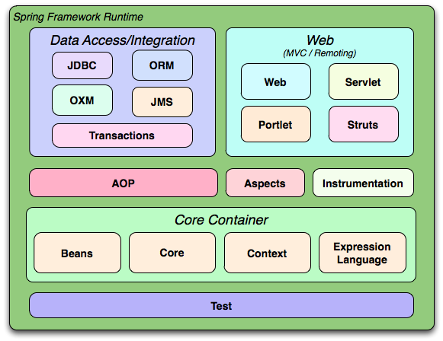

Slide 5
What is Spring / DI / IoC Container?

Slide 6
1.What is Container?

Slide 7





Container
con·tain·er
1. A receptacle, such as a carton, can, or jar, in which material is held or carried. Anything that contains or can contain something, as a carton.
2. A large reusable receptacle that can accommodate smaller cartons or cases in a single shipment, designed for efficient handling of cargo.

Slide 8
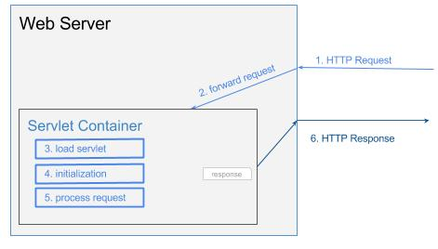
Web Server
Notes:
Web server receives HTTP request
Web server forwards the request to servlet container
The servlet is dynamically retrieved and loaded into the address space of the container, if it is not in the container.
The container invokes the init() method of the servlet for initialization(invoked once when the servlet is loaded first time)
The container invokes the service() method of the servlet to process the HTTP request, i.e., read data in the request and formulate a response. The servlet remains in the container’s address space and can process other HTTP requests.
Web server return the dynamically generated results to the correct location

Slide 9
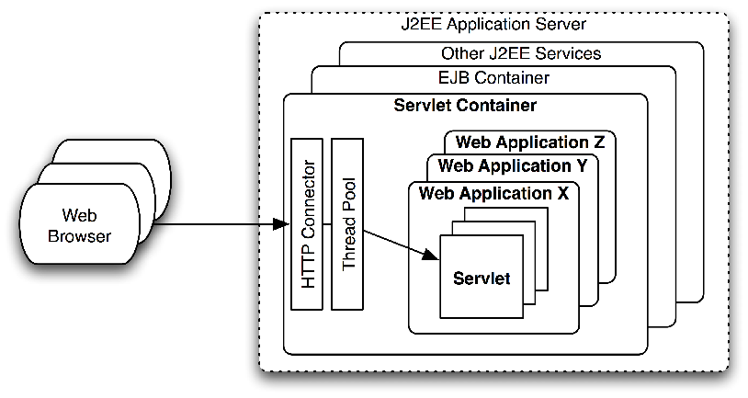
Containers
Notes:
Servlet lifecycle
A Web server is a program that, using the client/server model and the World Wide Web's Hypertext Transfer Protocol ( HTTP ), serves the files that form Web pages to Web users (whose computers contain HTTP clients that forward their requests). Every computer on the Internet that contains a Web site must have a Web server program.

Slide 10
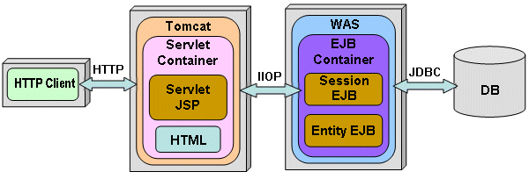
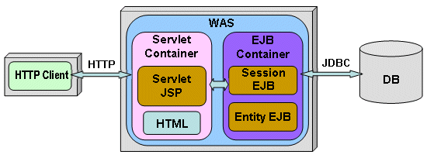
Containers
Notes:
Servlet lifecycle
A Web server is a program that, using the client/server model and the World Wide Web's Hypertext Transfer Protocol ( HTTP ), serves the files that form Web pages to Web users (whose computers contain HTTP clients that forward their requests). Every computer on the Internet that contains a Web site must have a Web server program.

Slide 11
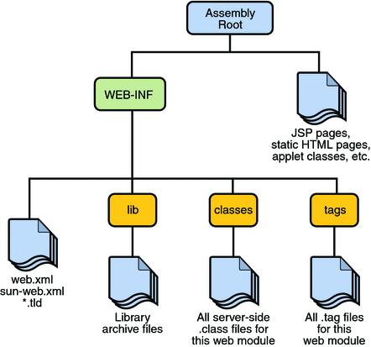
Web Application(.war)

Slide 12
Servlet Container vs. Spring Container
Manages lifecycle (servlet vs. bean)
web.xml vs. beans.xml
Routine and housekeeping tasks
(instantiating, configuring, and assembling) & (init , service, destroy)
Managed Beans vs. “Managed” Servlet
Spring IoC is built on top of Servlet Container

Slide 13
Problem 1

Slide 14
Tight Coupling
Payment
savingsAccount
pay()
SavingsAccount
accountNumber
getDetails()
new X()
Client
calls pay()
com.springtraining.coupling1
Notes:
Show example com.springtraining.coupling1

Slide 15
Solution1
Program to the Interface
Use Factory Design Pattern
com.springtraining.coupling2.interfacesol

Slide 16

Factory
A building or group of buildings with facilities for the manufacture of goods.
Using Factory Design Pattern we create / manufacture objects in programming world
com.springtraining.coupling2.factory
Notes:
com.springtraining.coupling2.factory

Slide 17
Factory Design Pattern
The client needs a set of products(implementing common interface), but instead of creating it directly using the new operator, it asks the factory for a new product, providing the information about the type of object it needs.
You may not know ahead of time what objects you might need!
Creates objects without exposing the instantiation logic to the client. Client doesn’t need to know all subclasses / implementations.
Encapsulates object creation process.
It introduces weak coupling instead of tight coupling by hiding concrete classes from the application.
Introduction of new implementations(e.g. account Types) becomes seamless. Only factory needs to change in the example.

Slide 18
Problem 2

Slide 19
Coupling with Pull Mechanism
Object B
Creates
Object A
Object C
Creates
PULL Mechanism

Slide 20
Problem
Application still has dependencies with coupling and using new operator.
Application is instantiating, configuring , assembling & managing object lifecycles!

Slide 21
Solution 2

Slide 22
Injection
CONSTRCUTOR
public Payment(SavingsAccount savingsAccount) {
this.savingsAccount = savingsAccount;
}
SavingsAccount
accountNumber
getDetails()
Payment
savingsAccount
pay()
Assembler
SETTER
public void setSavingsAccount(SavingsAccount savingsAccount) {
this.savingsAccount = savingsAccount;
}
Client
calls pay()
com.springtraining.constructorInjection
com.springtraining.setterInjection
Notes:
First Constructor Injection that happens during memory allocation Second Setter Injection that happens After memory allocation and object Initialization.

Slide 23
IOC/DI
Object B
setB(B)
Object A
Object C
setC(C)
PUSH Mechanism
Notes:
Container is responsible for injecting the dependencies B & C into A.
Hollywood Principle : Don’t call us, we will call you.

Slide 24
Spring IOC/DI
SavingsAccount
accountNumber
getDetails()
Payment
account
pay()
BeanFactory
or SpringContext
CurrentAccount
accountNumber
getDetails()
Client
calls pay()
com.springtraining.springbeanfactory
Notes:
com.springtraining.springbeanfactory
DI/IOC is a process whereby objects define their dependencies
Constructor arguments
Arguments to a factory method
properties that are set on the object instance after it is constructed or returned from a factory method.
The container then injects those dependencies when it creates the bean

Slide 25
IoC Container
Business Object (POJO)
Fully Configured System Ready To Use
Configuration
Metadata
Spring Container
Produces
Notes:
JavaBeans are reusable software components for Java. Practically, they are classes that encapsulate many objects into a single object (the bean). They are serializable, have a 0-argument constructor, and allow access to properties using getter and setter methods.
http://www.martinfowler.com/bliki/POJO.html
Shouldn’t ideally extend, implement & annotate any other class.

Slide 26
Spring IOC/DI
I(App) need an object as I described in config, I don’t care where and how you(IoC) get it from, <yell>JUST GET ME ONE</yell>. I will just use it & its your responsibility to manage it!!!
<yell> springContainer.getBean(“serviceA”); </yell>

Slide 27
Spring IOC/DI
Beans Managed by an IoC container are reusable and decoupled from business logic
IoC is in effect a configurable automatic factory which manages your beans.

Slide 28
Spring IOC/DI
Decouples object creators and locators from application logic
Beans Managed by an IoC container using a centralized config are reusable and decoupled from business logic

Slide 29
Spring IOC/DI
Spring IoC container is responsible for managing bean(business object/POJO) lifecycle by
Instantiating
Configuring
Assembling
The container gets its instructions on what objects to instantiate, configure, and assemble by reading configuration metadata. The configuration metadata is represented in XML, Java annotations, or Java code.

Slide 30
Constructor vs. setter injection
 | Constructor injection | Setter injection
1) | As its name implies constructor is used to inject any dependency on spring managed beans | As its name implies setter methods like setProperty() is used to inject any dependency on spring managed bean.
2) | Partial dependency is not possible here, as you have to enter all parameters of constructor. Otherwise an exception can be thrown or unwanted constructor will be called. | In Setter Injection, partial injection of dependencies is possible, means if we have 3 dependencies like int, string, long, then its not necessary to inject all values if we use setter injection. If you does not inject it will takes default values for those primitives
3) | If you provide both type of injection for the same property then Constructor injection can not override setter injection. | But Setter injection will override Constructor injection

Slide 31
Constructor vs. setter injection
 | Constructor injection | Setter injection
4) | If you have more dependency , say 15 or more then its recommended to use constructor injection. As it minimizes code. | Setter injection is not recommended for larger dependencies as you have to write that much setters.
5) | Constructor injection is not that flexible because it will always create a new bean instance. | Setter injection is flexible as it doesn’t create new instances all the time which makes it easy to change values
6) | Allows you to assign values to final field variable. | Setter injection doesn’t allows this
7) | Constructor injection makes bean class object as immutable [We can’t change ] | Setter injection makes bean class object as mutable [We can change ]

Slide 32
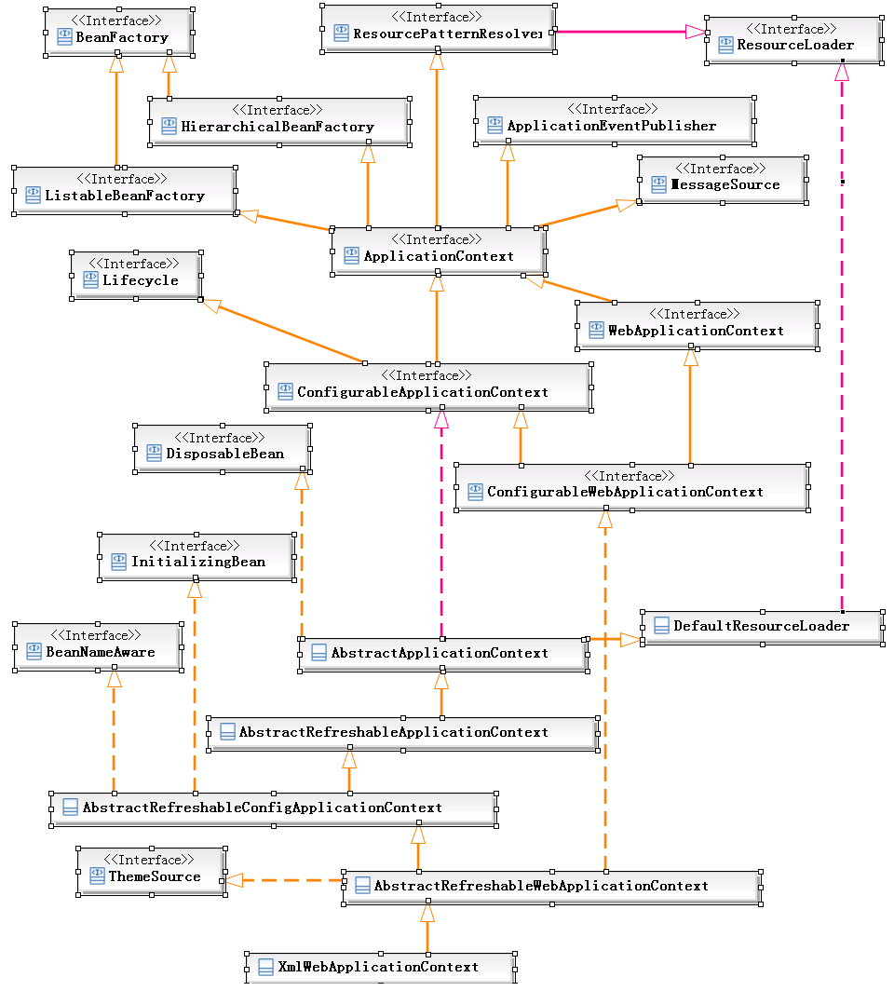
Spring Container Hierarchy

Slide 33
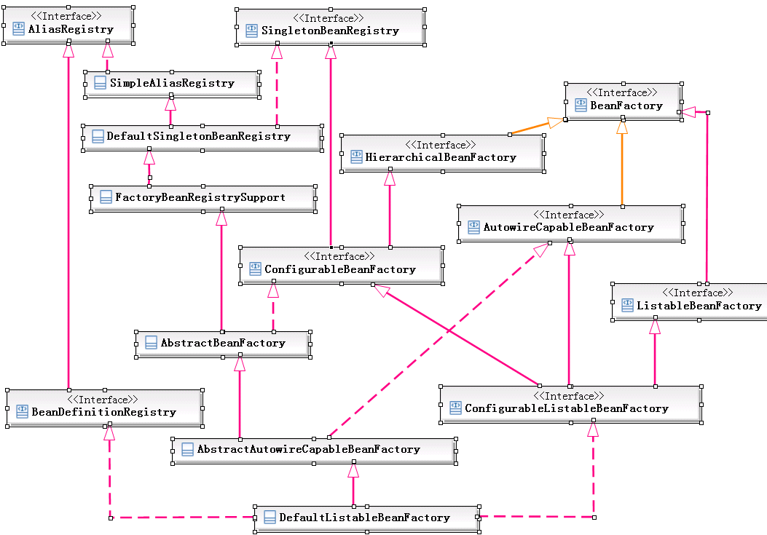
Spring Container Hierarchy

Slide 34
Spring IOC containers
BeanFactory
ApplicationContext
BeanFactory
ClassPathXML
ApplicationContext
AnnotationConfig
ApplicationContext
ApplicationContext
FileSystemXML
ApplicationContext
WebApplicationContext
Interface
XMLWeb
ApplicationContext
AnnotationConfigWebApp
AlicationContext
Class

Slide 35
BeanFactory vs. Application Context
Use an ApplicationContext unless you have a really good reason for not doing so! But Why?
ApplicationContext includes all functionality of the BeanFactory as factory is extended by context.
If memory consumption is critical and u don’t need extra features, then in these extreme cases(say applet or mobile apps) you might like to use Spring BeanFactory.

Slide 36
BeanFactory vs. ApplicationContext
Feature | ApplicationContext | BeanFactory
Bean instantiation/wiring | Yes | Yes
Automatic BeanPostProcessor registration | Yes | No
Automatic BeanFactoryPostProcessor registration | Yes | No
Convenient Message Source Access (for i18n) | Yes | No
ApplicationEvent Publication | Yes | No
In short, the BeanFactory provides the configuration framework and basic functionality, and the ApplicationContext adds more enterprise-specific functionality. The ApplicationContext is a complete superset of the BeanFactory.

Slide 37
Namespace – Name Conflict
XML element names are defined by developers and is open to name conflicts.
This XML carries HTML table information:
<table> <tr> <td>Apples</td> <td>Bananas</td> </tr> </table>
If these XML fragments were added together, there would be a name conflict. Both contain a <table> element, but the elements have different content and meaning.
An XML parser will not know how to handle these differences.
Name conflicts in XML can easily be avoided using a name prefix.
This XML carries information about a table (a piece of furniture):
<table> <name>African Coffee Table</name> <width>80</width> <length>120</length> </table>

Slide 38
Namespace – Prefix Solution
XML element names are defined by developers and is open to name conflicts.
This XML carries information about an HTML table, and a piece of furniture:
<h:table> <h:tr> <h:td>Apples</h:td> <h:td>Bananas</h:td> </h:tr> </h:table> <f:table> <f:name>African Coffee Table</f:name> <f:width>80</f:width> <f:length>120</f:length> </f:table>

Slide 39
Namespace – Namespace
When using prefixes in XML, a so-called namespace for the prefix must be defined. The namespace is defined by the xmlns attribute in the start tag of an element.The namespace declaration has the following syntax. xmlns:prefix="URI".
<root> <h:table xmlns:h="http://www.w3.org/TR/html4/"> <h:tr> <h:td>Apples</h:td> <h:td>Bananas</h:td> </h:tr> </h:table> <f:table xmlns:f="http://www.w3schools.com/furniture"> <f:name>African Coffee Table</f:name> <f:width>80</f:width> <f:length>120</f:length> </f:table> </root>
<root xmlns:h="http://www.w3.org/TR/html4/
xmlns:f="http://www.w3schools.com/furniture"> <h:table> <h:tr> <h:td>Apples</h:td> <h:td>Bananas</h:td> </h:tr> </h:table> <f:table> <f:name>African Coffee Table</f:name> <f:width>80</f:width> <f:length>120</f:length> </f:table> </root>

Slide 40
Namespace - URI
The namespace URI is not used by the parser to look up information.
The purpose is to give the namespace a unique name.
However, often companies use the namespace as a pointer to a web page containing namespace information.
What Do Namespace Names Point At?
One of the confusing things about all this is that namespace names are URLs; it's easy to assume that since they're Web addresses, they must be the address of something. They're not; these are URLs, but the namespace draft doesn't care what (if anything) they point at. They are nothing but unique pieces of texts.
The reason that the W3C decided to use URLs as namespace names is that they contain domain names (e.g. www.google.com), which work globally across the Internet.

Slide 41
Namespace
This line tells the XML parser that this document should be validated against a schema
<?xml version="1.0" encoding="UTF-8"?>
<beans xmlns="http://www.springframework.org/schema/beans"
xmlns:anyText="http://www.w3.org/2001/XMLSchema-instance"
anyText:schemaLocation="http://www.springframework.org/schema/beans
http://www.springframework.org/schema/beans/spring-beans-3.0.xsd">
This prefix can be any text and is traditionally xsi
This line specifies WHERE the schema resides with the help of org.springframework.beans-X.X.X.jar/spring.schema. Many jars would have this file.
XSD(XML schema Definition) is the rule which governs the XML structure and content
Notes:
http://static.springsource.org/spring/docs/3.0.1.RELEASE/api/org/springframework/beans/factory/xml/NamespaceHandlerSupport.html

Slide 42


Managed Beans

Slide 43
Managed beans Topics
Naming Beans
Constructor Based Injection Details
Setter Based Injection Details
Handling Multiple Configuration files
Instantiating Beans

Slide 44
Managed Bean Story Board
PaymentDBService
paymentDBService
createInstance()
execSQL()
Payment
Account
paymentDBSvc
pay()
SpringContext
SavingsAccount
accountNumber
getDetails()
Client
calls pay()
Notes:
DI/IOC is a process whereby objects define their dependencies
Constructor arguments
Arguments to a factory method
properties that are set on the object instance after it is constructed or returned from a factory method.
The container then injects those dependencies when it creates the bean

Slide 45
Naming Beans
Name | ID
name attribute is flexible. Doesn't have XML char restriction. | id attribute conforms to the XML id attribute standards.(must start with a letter or underscore, and can only contain letters, digits, underscores, hyphens, and periods)
name can contain multiple aliases separated by a comma, semicolon or whitespace. | id must be a single value.
We can use bean element called <alias> for adding additional names for a single bean.
Notes:
This means that it must start with a letter or underscore, and can only contain letters, digits, underscores, hyphens, and periods.

Slide 46
Constructor based Injection
Default Sequence
<bean id="acc1“ class="com.springtraining.spring.constructorinjection.SavingsAccount">
<constructor-arg ref="accNo"></constructor-arg>
<constructor-arg value="MrXDefault"></constructor-arg>
</bean>
Indexed
<bean id="acc2“ class="com.springtraining.spring.constructorinjection.SavingsAccount">
<constructor-arg index="1" value="MrXIndexed"></constructor-arg>
<constructor-arg index="0" value="12345"></constructor-arg>
<constructor-arg index="2" value="20/7/2013"></constructor-arg>
</bean>
Typed
<bean id="acc3“ class="com.springtraining.spring.constructorinjection.SavingsAccount">
<constructor-arg type="java.lang.String" value="MrXTyped"></constructor-arg>
<constructor-arg type="java.util.Date" value="20/7/2013"></constructor-arg>
<constructor-arg type="int" value="12345"></constructor-arg>
</bean>

Slide 47
Setter Based Injection
Name - Value
<property name="customerName" value="MrX"></property> >
Name - ref
<property name="savingsAccount" ref="acc1"></property>
<bean id="acc1“ class="com.springtraining.spring.setterinjection.SavingsAccount">
<property name="accountNumber" value="12345"></property>
<property name="customerName" value="MrX"></property>
<property name="dob" value="20/7/2013"></property>
</bean>

Slide 48
Handling multiple config Files
Import
<!-- Import config file present anywhere in the war, even in jars -->
<import resource="classpath:com/springtraining/spring/multipleconfigs/bean-config-dbservices.xml" />
<!-- Import config file in same folder -->
<import resource="bean-config-models.xml"/>
String Array
new ClassPathXmlApplicationContext(
new String[] {"paymentservice.xml","statementservice.xml" })
Merging context
new ClassPathXmlApplicationContext(“newConfig.xml",existingContext);

Slide 49
Instantiating Beans
Instantiation with a constructor
<bean id="acc" class="com.springtraining.springbeanfactory.instantiation.SavingsAccount">
</bean>
Instantiation with a static factory method
<!-- Instantiation with a static factory method -->
<bean id="paymentDBSvc"
class="com.springtraining.springbeanfactory.instantiation.PaymentDBService"
factory-method="createInstance"/>
Instantiation with an instance factory method
<!-- dbServiceLocator -->
<bean id="dbServiceLocator"
class="com.springtraining.springbeanfactory.instantiation3.InstancePaymentDBService"></bean>
<!-- the bean to be created via the Instance factory bean -->
<bean id="paymentDBSvc"
factory-bean="dbServiceLocator"
factory-method="createInstance" />

Slide 50
Managed beans Topics Cont.…
Compound property names
Injecting Null and empty values
XML shortcut with the p-namespace
Reference to other beans
Inner Beans & Method Injection

Slide 51
Compound property names
You can use compound or nested property names when you set bean properties, as long as all components of the path except the final property name are not null
<bean id="sample" class="sample.hello">
<property name="a.b.c" value="12" />
</bean>
= a.getB().setC(12);
<!-- Payment Service -->
<bean id="payment" class="com.springtraining.spring.compoundproperty.Payment">
<property name="savingsAccount" ref="acc"/>
<property name="savingsAccount.accountNumber" value="XYZ"/>
</bean>
Notes:
Here c will be set to 12 but a and b should be non null.

Slide 52
Injecting Null and empty
Spring treats empty arguments for properties as empty Strings
String
<bean class=“savingsAccount"> <property name="accountNumber" value=""/> </bean>
savingsAccount. setAccountNumber("");
<bean class=“savingsAccount"> <property name="accountNumber"/> </bean> -> Will be a runtime error “must specify a ref or value”
NULL
<bean class=" savingsAccount ">
<property name=" accountNumber "> <null/> </property>
</bean>
savingsAccount. setAccountNumber(null);

Slide 53
XML shortcut with the p-namespace
The p-namespace enables us to use the bean element's attributes, instead of nested <property/> elements, to describe your property values and/or collaborating beans.
<beans xmlns="http://www.springframework.org/schema/beans"
xmlns:xsi="http://www.w3.org/2001/XMLSchema-instance"
xmlns:p="http://www.springframework.org/schema/p"
xsi:schemaLocation="http://www.springframework.org/schema/beans
http://www.springframework.org/schema/beans/spring-beans-3.0.xsd">
<bean name="john-classic" class="com.example.Person">
<property name="name" value="John Doe"/>
<property name="spouse" ref="jane"/>
</bean>
<bean name="jane" class="com.example.Person">
<property name="name" value="Jane Doe"/>
</bean>
<bean name="john-modern" class="com.example.Person"
p:name="John Doe"
p:spouse-ref="jane"/>
</beans>

Slide 54
References to other beans
Name - ref
<property name="savingsAccount" ref="acc1"></property>
<bean id="acc1“ class="com.springtraining.spring.setterinjection.SavingsAccount">
<property name="accountNumber" value="12345"></property>
<property name="customerName" value="MrX"></property>
<property name="dob" value="20/7/2013"></property>
</bean>
2. <ref bean/local/parent=”beanId”>
<ref bean=" todaysDate"/>
<ref local=" paymentDBSvc"/>
<ref parent=" payment"/>
Notes:
Parent is like protected access modifier…is used to get bean from parent context

Slide 55
Inner Bean
A <bean/> element inside the <property/> or <constructor-arg/> elements defines a so-called inner bean.
An inner bean definition does not require a defined
id or name; the container ignores these values.
It also ignores the scope flag. Inner beans are always anonymous and they are always scoped as prototypes.
Used when the bean isn't reusable.

Slide 56
Method Injection
Specially when we are using 3rd party code and we can’t change something in it and needs overriding.
Method Injection as an alternative to subclassing(for overriding) in some corner cases, where the superclass should be kept isolated from a container dependency, and the container can more easily implement the necessary behaviour than a regular subclass.
Arbitrary method replacement
<!-- Payment Service -->
<bean id="payment" class="com.springtraining.spring.methodinject1.Payment">
<constructor-arg ref="acc"/>
<replaced-method name="pay" replacer="securePaymentReplacer"></replaced-method>
</bean>
Lookup method injection
<bean id="payment" class="com.springtraining.spring.methodinject2.Payment">
<lookup-method name="pay" bean="sAcc" />
</bean>
Obviously method injection wont work for final classes or methods
Notes:
In lookup method injection container injects methods only for those methods which return a Spring managed bean. Client class must have the following prototype of method to be injected <public|protected> [abstract] <return-type> nameOfTheMethod(); (i.e. public or protected, concrete or abstract,return type, no argument)

Slide 57
Managed beans Topics Cont.…
Bean Scopes(Singleton, Prototype, Request, Session, Global Session)
Collections in Spring(list , set, map & properties)
PropertyPlaceholderConfigurer

Slide 58
Collections in spring -List
<bean id="moreComplexObject" class=“com.spring.ComplexObject"> <!-- results in a setSomeList(java.util.List) call -->
<!-- java.util.List -->
<property name="listInstanceVar">
<list>
<value>1</value>
<ref bean="personBean" />
<bean class="com.springtraining.spring.collections.Person">
<property name="name" value="springList" />
<property name="address" value="address" />
<property name="age" value="28" />
</bean>
</list>
</property>
</bean>

Slide 59
Collections in spring – Set
<bean id="moreComplexObject" class=“com.spring.ComplexObject">
<!-- results in a setSomeSet(java.util.Set) call -->
<property name=“instanceVarSet">
<set>
<value>1</value>
<ref bean="personBean" />
<bean class="com.springtraining.spring.collections.Person">
<property name="name" value="springSet" />
<property name="address" value="address" />
<property name="age" value="28" />
</bean>
</set>
</property>
</bean>

Slide 60
Collections in spring – Map
<bean id="moreComplexObject" class=“com.spring.ComplexObject">
<!-- java.util.Map -->
<property name="mapInstanceVar">
<map>
<entry key="Key 1" value="1" />
<entry key="Key 2" value-ref="personBean" />
<entry key="Key 3">
<bean class="com.springtraining.spring.collections.Person">
<property name="name" value="springMap" />
<property name="address" value="address" />
<property name="age" value="28" />
</bean>
</entry>
</map>
</property>
</bean>

Slide 61
Collections in spring – Property
<bean id="moreComplexObject" class=“com.spring.ComplexObject">
<!-- results in a setSomeSet(java.util.Set) call -->
<!-- java.util.Properties -->
<property name="propertyTest">
<props>
<prop key="admin">admin@spring.com</prop>
<prop key="support">support@spring.com</prop>
<prop key="finance">finance@spring.com</prop>
</props>
</property>
</bean>

Slide 62
Collections Merging
<bean id="parentMap" abstract="true" class="com.springtraining.spring.collections.merge.ComplexObjectForMerge">
<property name="adminEmails">
<props>
<prop key="administrator">administrator@example.com</prop>
<prop key="support">support1@example.com</prop>
</props>
</property>
</bean>
<bean id=“mergeTest" parent="parentMap">
<property name="adminEmails">
<!-- the merge is specified on the *child* collection definition -->
<props merge="true">
<prop key="sales">sales@example.com</prop>
<prop key="support">support2@example.com</prop>
</props>
</property>
</bean>
You cannot merge different collection types (such as a Map and a List)

Slide 63
PropertyPlaceholderConfigure
Use the it to externalize property values from a bean definition into another separate file in the standard Java Properties format.
Doing so enables the person deploying an application to customize environment-specific properties such as database URLs and passwords, without the complexity or risk of modifying the main XML definition file or files for the container.
<!-- Payment DB Service -->
<bean id="paymentDBSvc"
class="com.springtraining.spring.properyplaceholder.PaymentDBService">
<property name="dbDetailsProp">
<props>
<prop key="driverClassName">${jdbc.driverClassName}</prop>
<prop key="url">${jdbc.url}</prop>
<prop key="username" >${jdbc.username}</prop>
<prop key="password">${jdbc.password}</prop>
</props>
</property>
</bean>
<bean class="org.springframework.beans.factory.config.PropertyPlaceholderConfigurer">
<property name="locations" value="classpath:jdbc.properties" />
</bean>

Slide 64
PropertyPlaceholderConfigure
The actual values come from another file in the standard Java Properties format:
jdbc.properties
jdbc.driverClassName=org.hsqldb.jdbcDriver
jdbc.url=jdbc:hsqldb:hsql://production:9002
jdbc.username=sa
jdbc.password=root

Slide 65
Bean Scopes
Scope | Description
Singleton | (Default) Single object instance per Spring IoC container.
Prototype | Number of object instances.
Request | Scopes a single bean definition to the lifecycle of a single HTTP request. Only applicable in Web Context.
Session | Scopes a single bean definition to the lifecycle of an HTTP Session. Only applicable in Web Context.
Global session | Scopes a single bean definition to the lifecycle of a global HTTP Session. Typically only valid when used in a portlet web context.
Notes:
globalSession is something which is connected to Portlet applications. When your application works in Portlet container it is built of some amount of portlets. Each portlet has its own session, but if your want to store variables global for all portlets in your application than you should store them inglobalSession. This scope doesn't have any special effect different from session scope in Servlet based applications.

Slide 66
Singleton Scope
ctx.getBean(“account”);
Spring
Container
account
Single
account Instance
Notes:
DI/IOC is a process whereby objects define their dependencies
Constructor arguments
Arguments to a factory method
properties that are set on the object instance after it is constructed or returned from a factory method.
The container then injects those dependencies when it creates the bean

Slide 67
Prototype Scope
ctx.getBean(“account”);
Spring
Container
Multiple
account Instances
Notes:
DI/IOC is a process whereby objects define their dependencies
Constructor arguments
Arguments to a factory method
properties that are set on the object instance after it is constructed or returned from a factory method.
The container then injects those dependencies when it creates the bean

Slide 68
Singleton beans with prototype-bean dependencies
When you use singleton-scoped beans with dependencies on prototype beans, be aware that dependencies are resolved at instantiation time. Thus if you dependency-inject a prototype-scoped bean into a singleton-scoped bean, a new prototype bean is instantiated and then dependency-injected into the singleton bean. The prototype instance is the sole instance that is ever supplied to the singleton-scoped bean.
However, suppose you want the singleton-scoped bean to acquire a new instance of the prototype-scoped bean repeatedly at runtime. You cannot dependency-inject a prototype-scoped bean into your singleton bean, because that injection occurs only once, when the Spring container is instantiating the singleton bean and resolving and injecting its dependencies.
Notes:
If you need a new instance of a prototype bean at runtime more than once, see Section 4.4.6, “Method injection”
Glue code and the evil singleton

Slide 69
Managed beans Topics Cont.…
Best Practices
NameSpace
AutoWiring

Slide 70
Auto Wiring
The Spring container can autowire relationships between collaborating beans. You can allow Spring to resolve collaborators (other beans) automatically for your bean by inspecting the contents of the ApplicationContext.
Autowiring can significantly reduce the need to specify properties or constructor arguments
Autowiring can update a configuration as your objects evolve. For example, if you need to add a dependency to a class, that dependency can be satisfied automatically your needing to modify the configuration.

Slide 71
Auto Wiring Modes
Mode | Description
byName | Autowiring by Bean’s property name.
byType | Autowiring by Bean’s property name. If more than one exists, a fatal exception is thrown, which indicates that you may not use byType autowiring for that bean. If there are no matching beans, nothing happens; the property is not set. If this is not desirable, setting the dependency-check="objects" attribute value specifies that an error should be thrown in this case.
Constructor | Analogous to byType, but applies to constructor arguments. If there is not exactly one bean of the constructor argument type in the container, a fatal error is raised.
Default/no | (Default) No autowiring
autodetect | Chooses constructor or byType through introspection of the bean class. If a default constructor is found, the byType mode is applied. DEPRECATED
Notes:
You cannot autowire so-called simple properties such as primitives, Strings, and Classes (and arrays of such simple properties). This limitation is by-design.
Check if the given type represents a "simple" property: a primitive, a String or other CharSequence, a Number, a Date, a URI, a URL, a Locale, a Class, or a corresponding array.Check if the given type represents a "simple" property: a primitive, a String or other CharSequence, a Number, a Date, a URI, a URL, a Locale, a Class, or a corresponding array.

Slide 72
AutoWiring Issues
Explicit dependencies in property and constructor-arg settings always override autowiring. You cannot autowire so-called simple properties such as primitives, Strings, and Classes (and arrays of such simple properties). This limitation is by-design.
Autowiring is less exact than explicit wiring.
Wiring information may not be available to tools that may generate documentation from a Spring container.
Multiple bean definitions within the container may match the type specified by the setter method or constructor argument to be autowired. For dependencies that expect a single value, this ambiguity is not arbitrarily resolved. If no unique bean definition is available, an exception is thrown.
Abandon auto in favour of explicit wiring.

Slide 73
Excluding Beans from AutoWiring
autowire-candidate attribute of the <bean/> element to false
default-autowire-candidates attribute of the <beans/> element to false

Slide 74
Beans Life Cycle
Spring Managed Bean Life Cycle
Initialisation
Destruction
Basics & Aware Interface
Lazy-Initialisation Mode

Slide 75
Simplified Bean lifecycle
Spring container declares, instantiates & initialises (via cons) the bean from config metadata using reflection API
The container has returned the bean to the application, and the application works with the methods of the bean.
populates the bean properties
Bean is now READY FOR USE
Application is Shutting Down
Beans are ready to be Garbage Collected
Container is being destroyed

Slide 76
Bean Initialisation
InitialisationBean interface
implements InitializingBean
public void afterPropertiesSet() throws Exception {
customerName="NameSetinafterPropertiesSet()";
System.out.println("afterPropertiesSet() called ");
}
Initialisation Method() ->Preferred
<bean id="acc1" class="com.springtraining.spring.lifecycle.SavingsAccount" init-method="customInitMethod">
public void customInitMethod(){
accountNumber=123;
System.out.println("initAccount() called");
}
Notes:
Post property set

Slide 77
Bean Destruction
DisposableBean interface
implements DisposableBean
public void destroy() throws Exception {
System.out.println("destroy() called ");
}
Destroy Method() ->Preferred
<bean id="acc1" class="com.springtraining.spring.lifecycle.SavingsAccount" destroy-method="cleanup">
public void cleanup(){
System.out.println(" cleanup() called");
}
Notes:
Post property set

Slide 78
Lazy Initialisation
A lazy-initialized bean tells the IoC container to create a bean instance when it is first requested, rather than at start-up.
<bean id="acc1" class="com.springtraining.spring.lifecycle.CurrentAccount" lazy-init="true">
We can control lazy-initialization at the container level by using the default-lazy-init attribute on the <beans/> element.
<?xml version="1.0" encoding="UTF-8"?>
<beans default-lazy-init="true " default-destroy-method="cleanup" default-init-method="customInitMethod" xmlns="http://www.springframework.org/schema/beans
Notes:
Generally, this pre-instantiation is desirable, because errors in the configuration or surrounding environment are discovered immediately, as opposed to hours or even days later. When this behavior is not desirable, you can prevent pre-instantiation of a singleton bean by marking the bean definition as lazy-initialized.
The default behavior for ApplicationContext implementations is to eagerly pre-instantiate all singleton beans at startup. Pre-instantiation means that an ApplicationContext will eagerly create and configure all of its singleton beans as part of its initialization process. Generally this is a good thing, because it means that any errors in the configuration or in the surrounding environment will be discovered immediately (as opposed to possibly hours or even days down the line).

Slide 79
Aware Interfaces
Spring offers a range of Aware interfaces, which are used to allow the beans to indicate to the container that they require a certain infrastructure dependency.
Typically, you do not implement any of these interfaces as it will couple your code to Spring. And Spring doesn't want you to do that anyway. But it is a hook to the Spring Initialization phase.

Slide 80
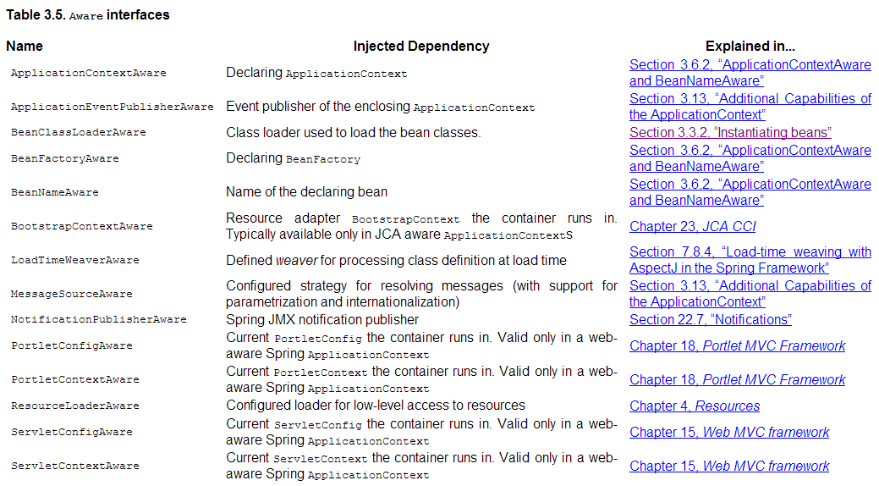
Aware Interface
Notes:
The name(Aware) is just a convention on Spring meaning that some special framework object is going to be injected to that class if it is managed by the framework.

Slide 81
Detailed & Custom Bean lifecycle
IoC container will look for the configuration metadata of given Bean.
Once found, container will create the instance of Bean(Using reflection API).
After instance creation dependencies will be injected(DI).
If (bean instance of BeanNameAware)
Container calls bean.setBeanName(bean id)
If (bean instance of BeanFactoryAware)
Container calls bean.setBeanFactory(container)
If (bean instance of ApplicationContextAware)
Container calls bean.setApplicationContext(container)
If (container has BeanPostProcessors)
Container calls postProcessBeforeInititialization() method of BeanPostProcessors
If (bean instance of InitializingBean)
Container calls bean.afterPropertiesSet()
If bean declares custom init method
Container calls custom init method of bean
If (container has BeanPostProcessors)
Container calls postProcessAfterInititialization() method of BeanPostProcessors
Bean is now ready for use by client.
While step 4 occurs when the BeanFactory is used, step 5 occurs only when working with the ApplicationContext.

Slide 82
Managed Bean Lifecycle Advance
Bean factory implementations should support the standard bean lifecycle interfaces as far as possible. The full set of initialization methods and their standard order is:
Step 1 to 4
ResourceLoaderAware's setResourceLoader (only applicable when running in an application context)
ApplicationEventPublisherAware's setApplicationEventPublisher (only applicable when running in an application context)
MessageSourceAware's setMessageSource (only applicable when running in an application context)
Step 5 or 6
ServletContextAware's setServletContext (only applicable when running in a web application context)
Step 7 to 10

Slide 83
Detailed & Custom Bean lifecycle
When the application is shutting down, it will result in the container being destroyed too. Naturally the beans are also approaching the end of their lifecycle. Before that there are a few steps than can be customised:
If (bean instance of DisposableBean)
Container calls the bean.destroy()
If bean declares custom destroy method
Container calls custom destroy method of bean
Bean is ready for garbage collection.

Slide 84
Best Practices
Avoid using autowiring
Use naming conventions
Use the XML "id" attribute to identify a bean
Use shortcut forms
Prefer type over index for constructor argument matching
Reuse bean definitions, if possible
Add a header comment to each configuration file
Prefer setter injection over constructor injection(Constructor injection to promote thread safety if all params are known in advance).
Do not abuse dependency injection
DO NOT use version numbers with the Spring schema namespaces
Always use classpath:/ prefix for consist resource referencing
Always use a single XML config file to bootstrap the application or tests
Use Properties for configurable resources.Dont hard code.
DO NOT use the SysOut Over SLF4J for anything other than migration
Notes:
http://www.onjava.com/pub/a/onjava/2006/01/25/spring-xml-configuration-best-practices.html
http://gordondickens.com/wordpress/2012/07/30/enterprise-spring-framework-best-practices-part-3-xml-config/

Slide 85
RECAP Chapter1
Part A

